Slide 1
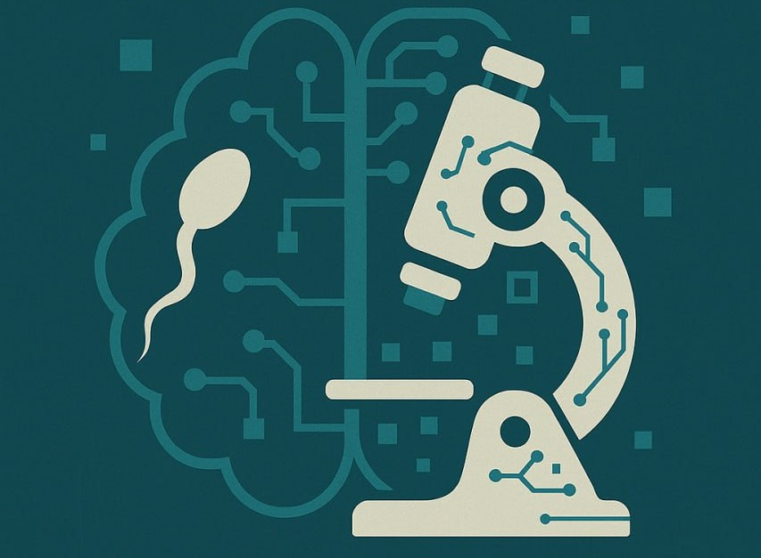
Ai-Powered Medical Lab for Sperm Morphology Detection & Classification
Under Supervision of:
Dr. Ahmed Elngar
Eng. Bahaa El-din Helmy

Slide 2
outline
01 – Introduction
02 – What we did
03 – Proposed Model
04 – Desktop Application
05 – ChatBot
06 - High-Level System Overview
07 – Front-end

Slide 3
INTRODUCTION

Slide 4
Problem Statement
Sperm morphology assessment is essential for male fertility evaluation but relies heavily on manual microscopic analysis. This process is inherently subjective , time-consuming , and susceptible to inter- and intra-observer variability , leading to inconsistent diagnoses. The lack of standardized, objective methods across laboratories further undermines reliability. These challenges necessitate an automated, accurate, and robust system that leverages image processing and Deep learning to detect and classify sperm morphology, improving diagnostic consistency, efficiency, and clinical decision-making in reproductive health.

Slide 5
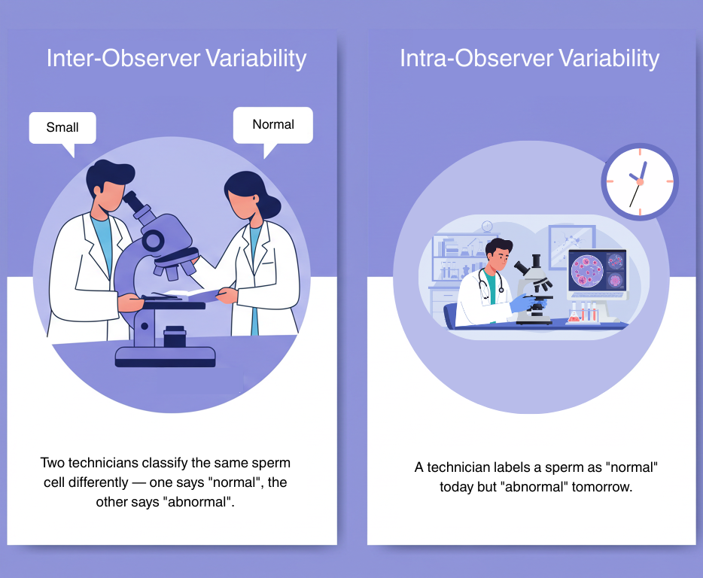
Problem Statement
Inter-Observer Variability
- Definition: Differences in results or interpretations between different observers (e.g., lab technicians or clinicians) analyzing the same sample.
Intra-Observer Variability
- Definition: Differences in results when the same observer analyzes the same sample at different times .

Slide 6
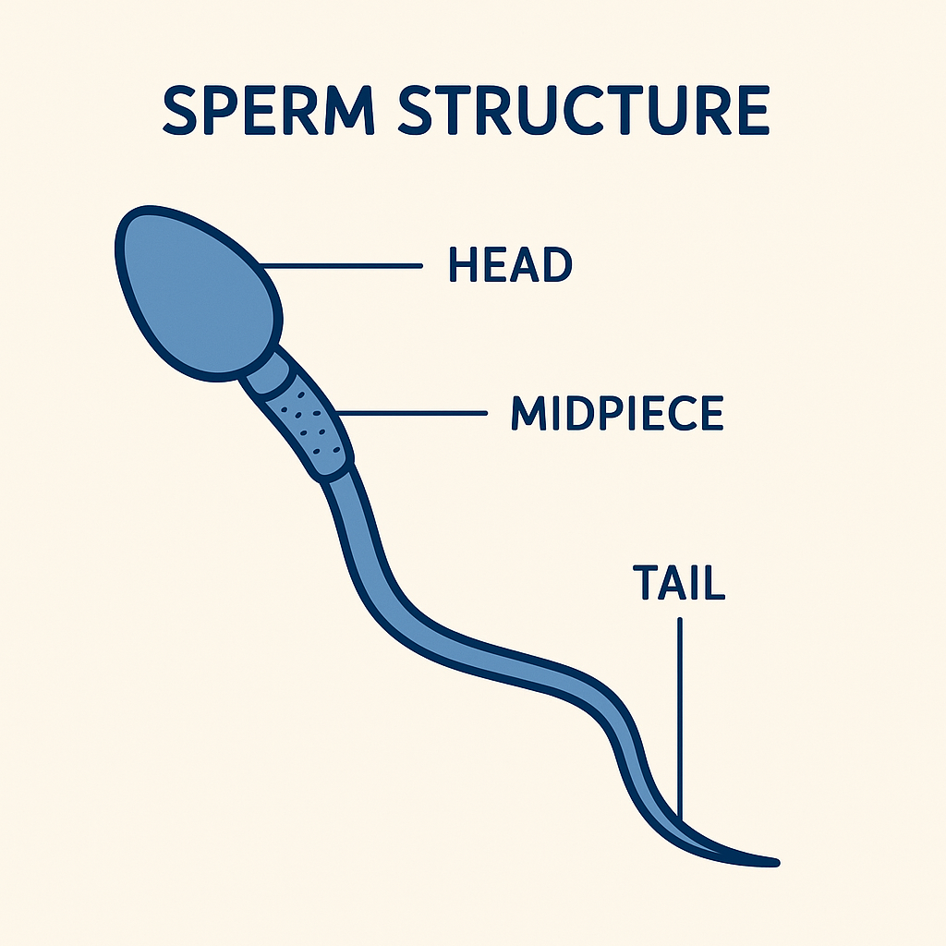
How It Work
We Focus on the Head
The ways to define sperm types:
Morphology : The shape and structure of sperm cells (head, midpiece, tail). Abnormal shapes are classified separately (e.g., double heads, bent tails).
Concentration : The number of sperm cells per milliliter of semen. This defines if the sample is normal or oligospermic (low count).

Slide 7
Related Work
Methodologies Used Before:
Early ML Approaches Rely on Handcrafted Features (KNN, PCA, Fourier Descriptors)
Limited Generalization Due to Manual Feature Extraction
YOLO-Based Models Struggle with Low-Quality Images and Small Objects
Current CNN Architectures Face Challenges in Real-World Clinical Settings
Their Flaws (weaknesses) :
They only Train on 1-2 Class Types
Uses Slow & Classification modesl that is not for real world use ( Research only)
They use Publicaly Published Datasets

Slide 8
WHAT WE DID…

Slide 9

Dataset Collection
The dataset used in this study was collected from Bedaya Center , a specialized fertility clinic located in [City, Country]. The samples were obtained from patients undergoing routine semen analysis as part of their infertility assessment. A total of ~4000 semen samples were collected following standard clinical protocols. From each sample, high-resolution microscopic images of sperm cells were captured using a digital microscope under consistent lighting and magnification conditions (typically 100x oil immersion objective).

Slide 10
Dataset Annotation
The collected sperm cell images were annotated using the LabelImg tool to outline and classify individual sperm heads. The annotation was performed under the supervision of a doctor from the Faculty of Applied Health Sciences Technology, Beni Suef University , to ensure medical accuracy. Each sperm head was labeled according to its morphological class, following WHO guidelines. This expert-guided annotation process helped ensure high-quality, reliable labels for training and evaluating the classification model.
Number of Classes
Normal
Abnormal Acrosome.
Tapering
Round
Pin
6.Large
7.Thin
8.Pyriform (Pear-shaped)
9.Amorphous
10.Small
11.Elongated

Slide 11
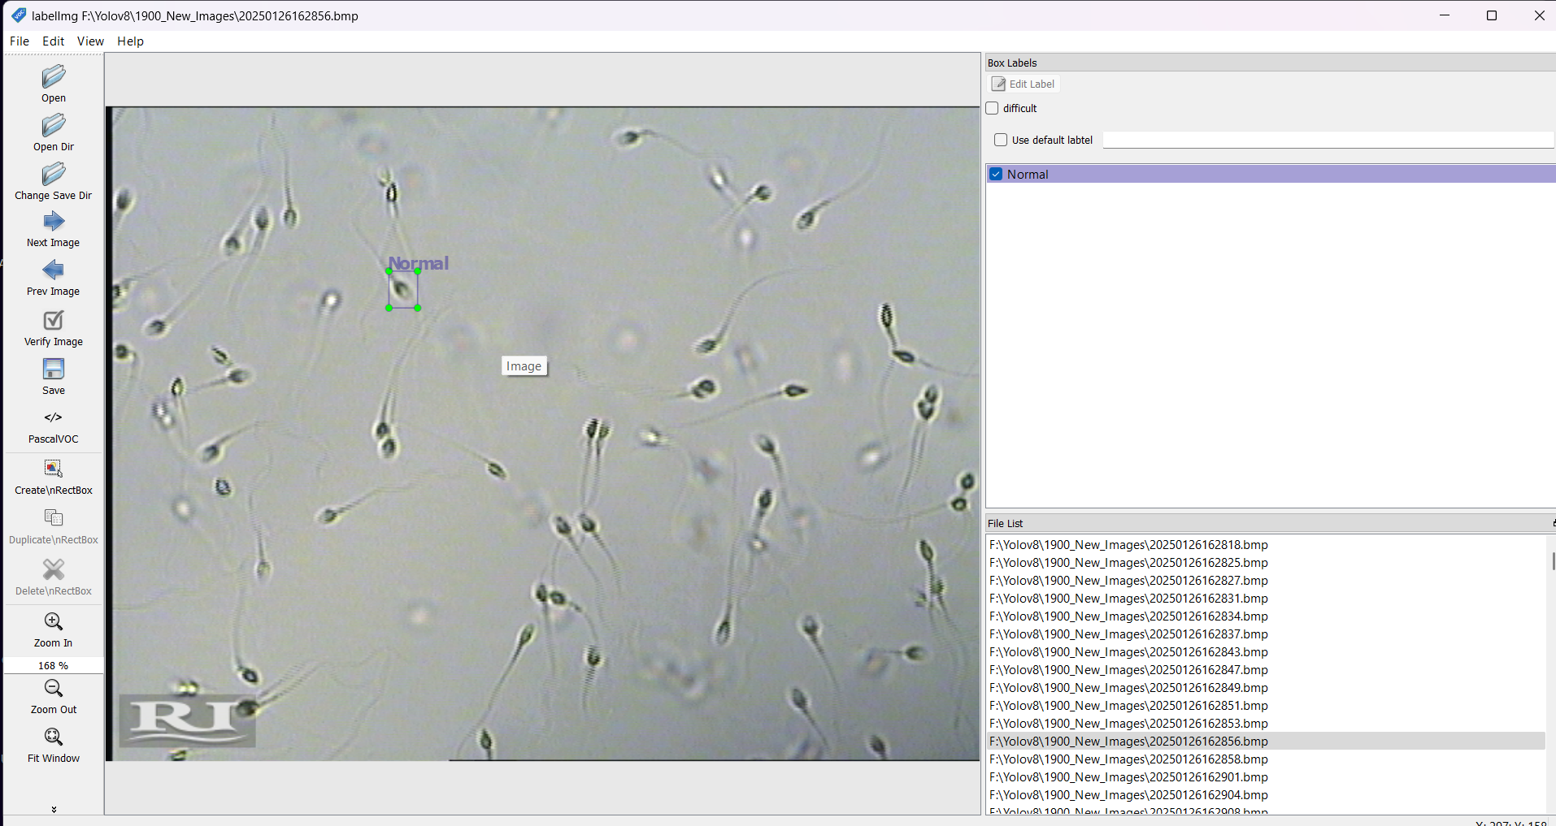
Dataset Annotation

Slide 12
Proposed Model (Our Model)

Slide 13
Our Model
We utilized RT-DETR (Real-Time Detection Transformer) for sperm detection, a cutting-edge deep learning model designed for fast and accurate object detection.
Why RT-DETR?
High Accuracy: Excels at detecting small objects like sperm cells with precise localization.
Real-Time Performance: Provides fast detection speeds, essential for laboratory environments requiring quick analysis.
Transformer Architecture: Captures global image context, improving the model's ability to detect subtle abnormalities.
Efficiency: Offers a strong balance between performance and computational cost, making it suitable for both web and desktop applications.

Slide 14
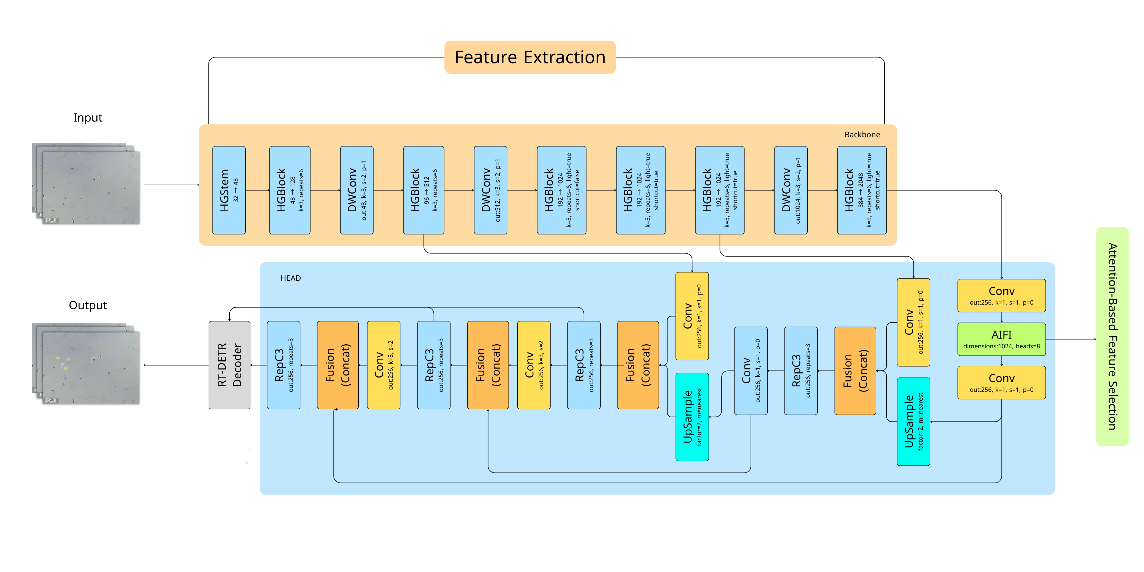
Model Architecture

Slide 15
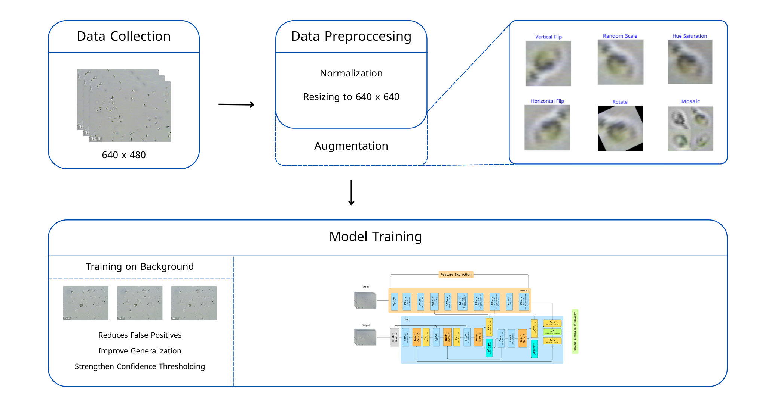
Workflow

Slide 16
Tools and Libraries
NumPy
Pandas
Pillow
Scikit-Learn
Pytorch
MatPlotLib
Kaggle
LabelImg

Slide 17
Desktop Application

Slide 18
Application idea
We develop a Desktop application to Guarantee uninterrupted lab work, enhances accuracy through direct equipment connection, and supports better patient care through structured data management.
Key Features:
Offline Support: Stores and manages data locally, allowing continuous work without internet access.
Equipment Integration: Can connect and integrate with laboratory equipment, enabling direct data import and reducing manual entry errors.
Multi-Sample Patient Tracking: Supports linking multiple samples to a single patient, facilitating easier monitoring of patient condition over time.

Slide 19
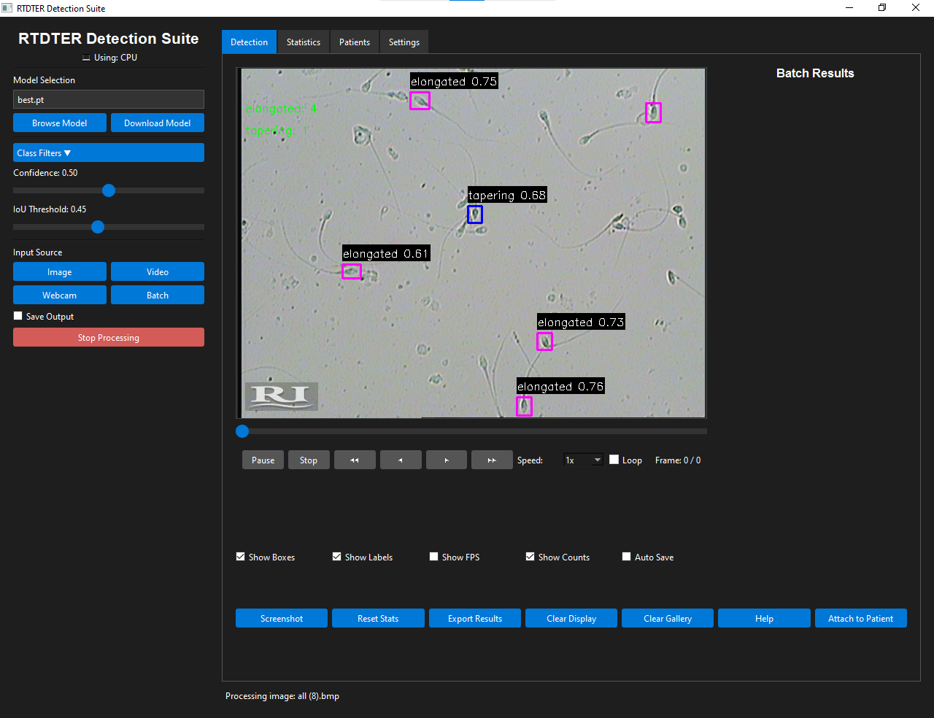
Screenshots
Objective: Detect and classify sperm cells from microscope images using a deep learning model.
Process Overview:
Mode l: RT-DETR
Input: Supports image, video, webcam, or batch processing.
Detection Output:
Identifies sperm shapes (e.g., elongated, tapering).
Draws bounding boxes and confidence scores on detected cells.
Displays total counts for each class (e.g., elongated: 4, tapering: 1).
Controls & Features:
Adjustable Confidence & IoU thresholds.
Options for saving output, looping, and frame control.
Export results and attach detection to patient records.

Slide 20
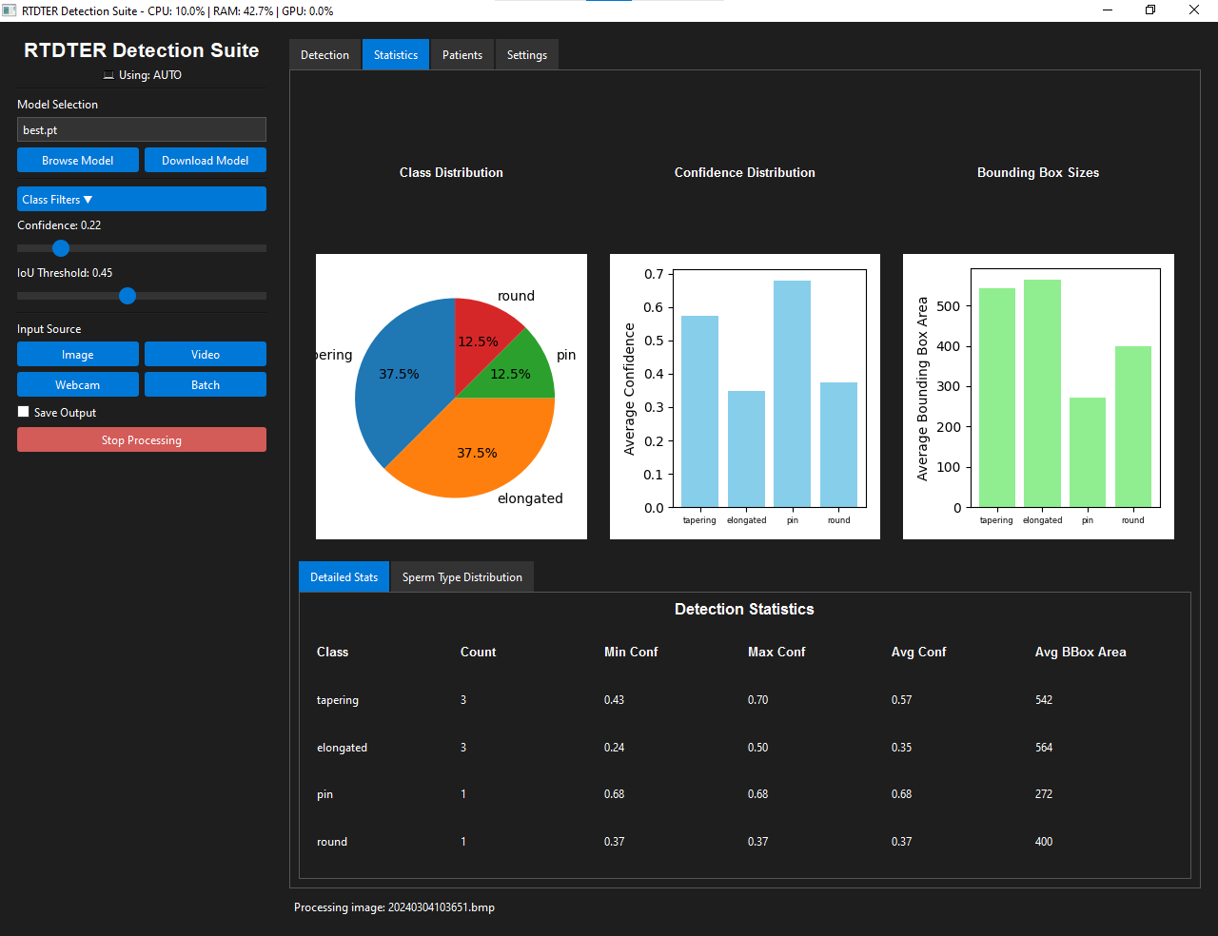
Screenshots
Purpose: Analyze the distribution and confidence of detected sperm morphologies for informed assessment.
Key Visualizations:
Class Distribution: Shows proportion of detected sperm types (e.g., elongated: 37.5%, tapering: 37.5%, etc.).
Confidence Distribution: Displays average detection confidence per class
Bounding Box Sizes: Indicates average object size per class, helpful for morphology comparison.

Slide 21
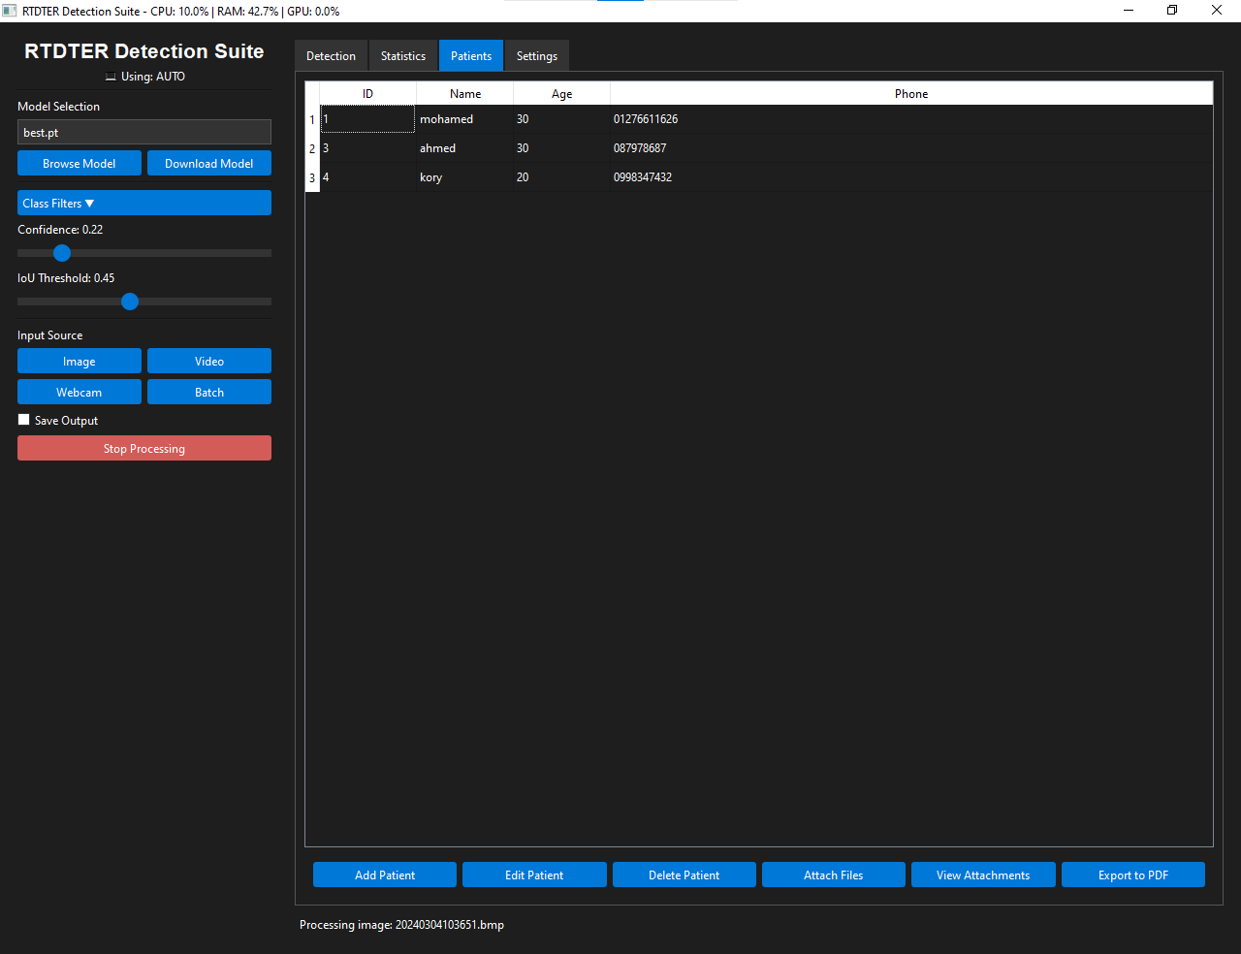
Screenshots
Patients Table:
This interface provides a centralized platform for managing patient records within a medical or diagnostic system.
Also include:
Patient List Display: Shows patient details including
( ID, Name, Age, and Phone.)
Action Buttons:
Add/Edit/Delete Patient – Manage patient entries.
Attach/View Files – Manage patient-related documents.
Export to PDF – Generate patient reports.

Slide 22
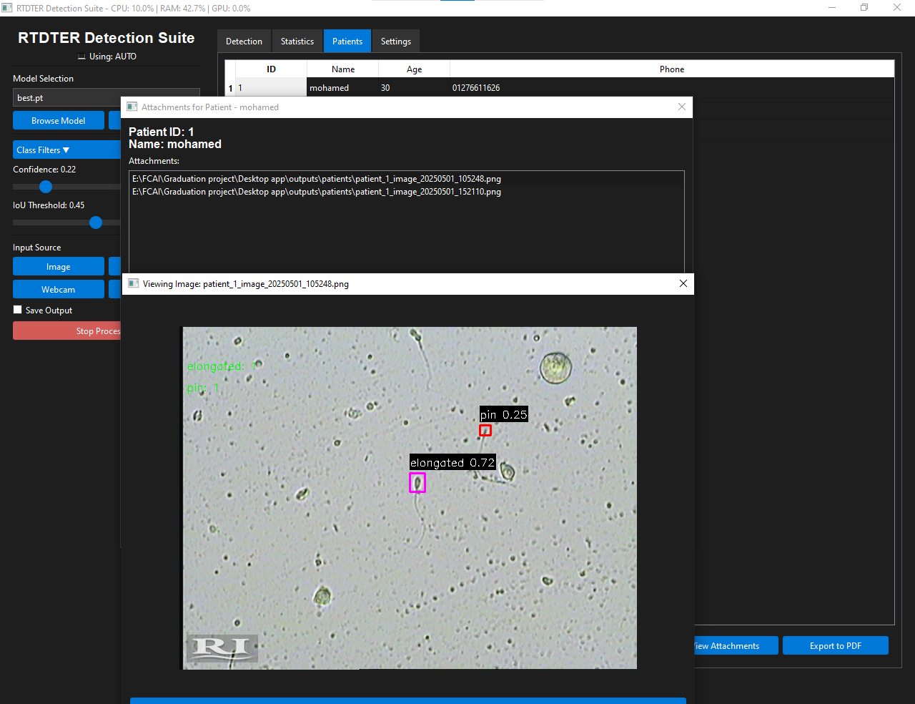
Screenshots

Slide 23
ChatBot

Slide 24
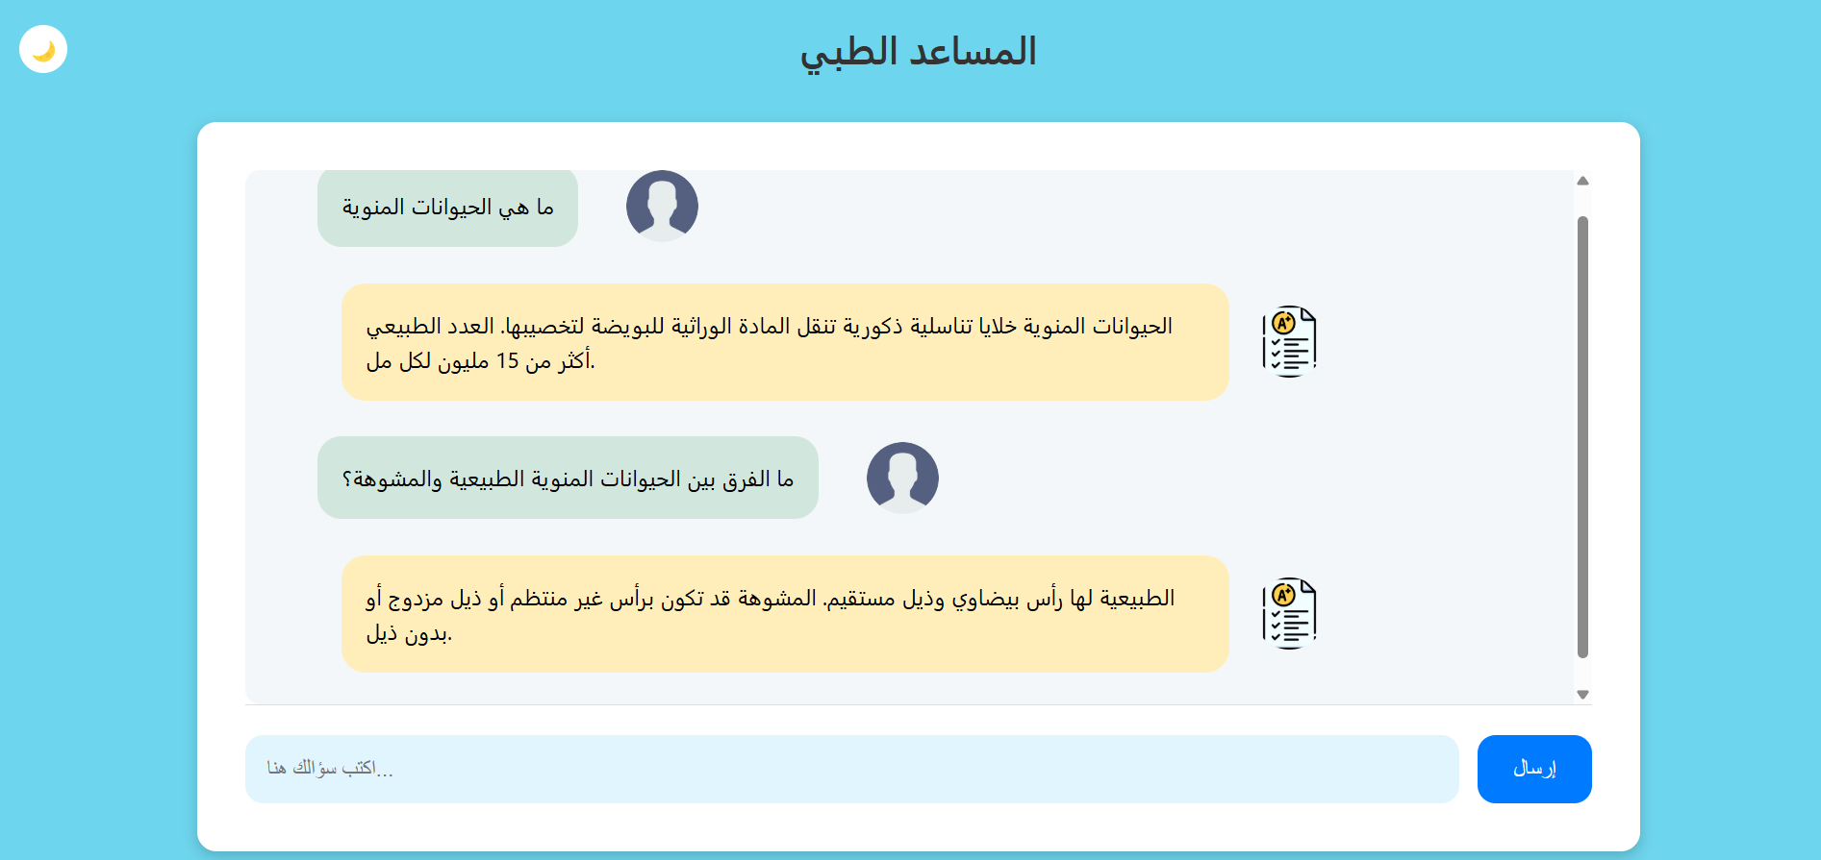
Medical Chatbot

Slide 25
Medical Chatbot
Goal: Create an intelligent assistant that answers fertility and medical questions in both Arabic and English using real-time information.
-Motivation:
Difficulty accessing trustworthy medical info, especially in Arabic.
Increasing interest in fertility education and male reproductive health.
Desire to apply AI for social good.

Slide 26
High-Level System Overview

Slide 27
System Features
-Smart Assistant: powered by LLaMA-3 (via Groq API).
- Information Retrieval from:
Wikipedia (Arabic and English)
DuckDuckGo (for general medical queries)
-Bilingual Support:
Understands and answers in Arabic and English.
Uses translation when needed.
-Custom Knowledge:
Preloaded sperm-related FAQs in Arabic.
Faster, accurate responses without hitting the API.
-Cache System: Saves previously answered questions to JSON for efficiency.
-Web-Based UI (Flask): ChatGPT-style frontend (via index.html)

Slide 28
Technical Architecture:
Backend Stack:
-Flask: Web server and route management.
-LangChain + Groq :
1:LLMs with tool calling capabilities.
2:Executes search queries dynamically.
Tools Integrated:
1: DuckDuckGoSearchRun: General search engine fallback.
2: WikipediaQueryRun: Focused on verified medical content.
Translation: deep_translator for English-to-Arabic fallback when result is in English
Caching: store question-answer pairs and Reduces API calls and latency for repeated questions

Slide 29
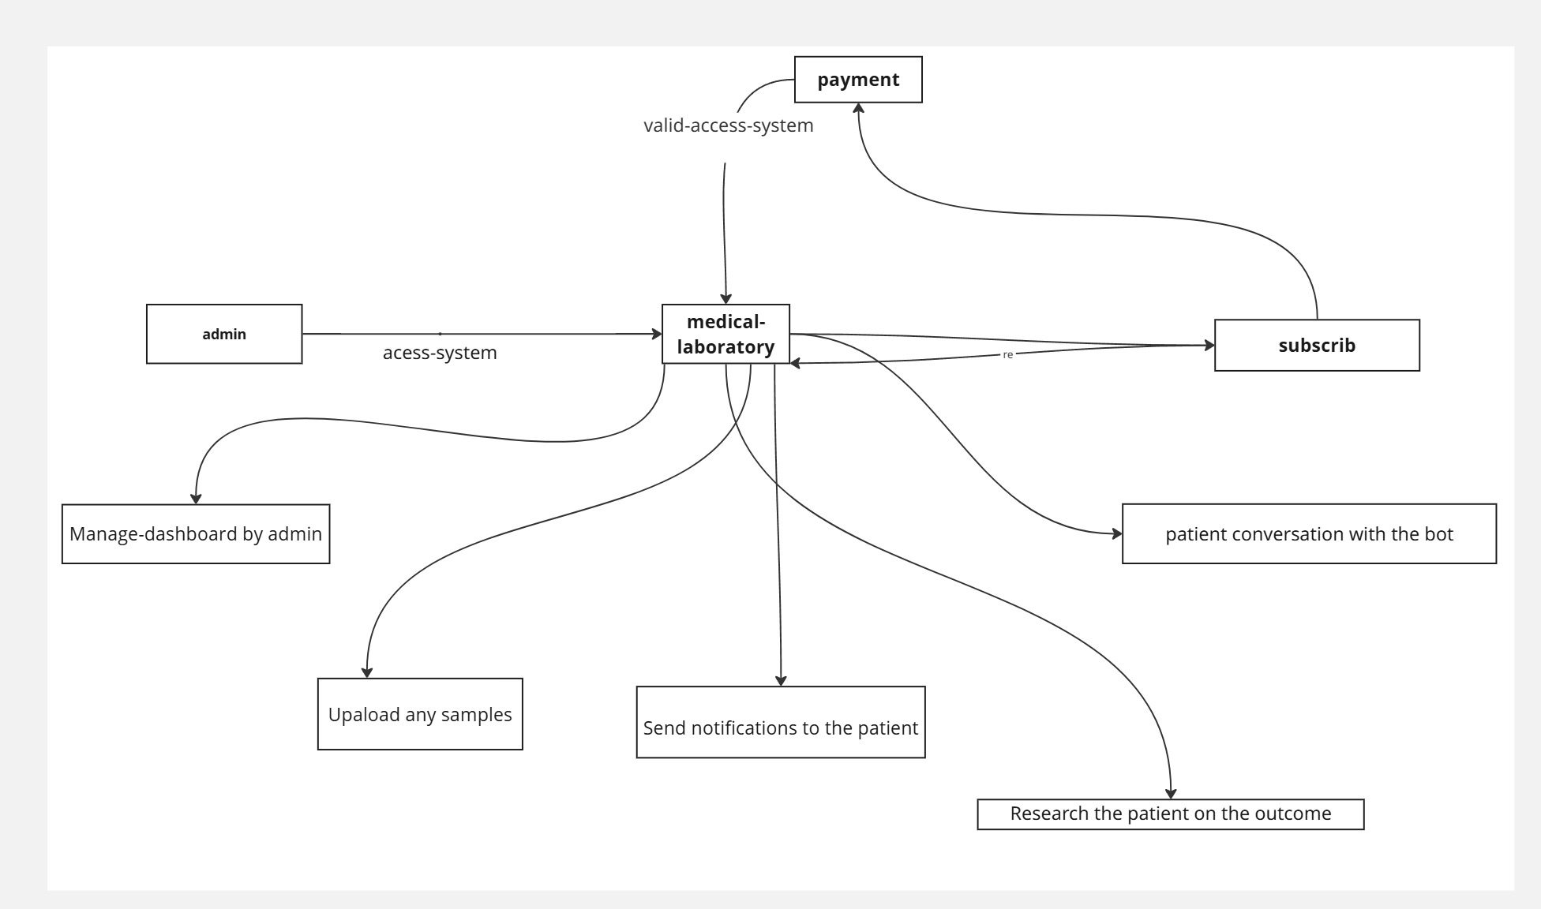
System architecture

Slide 30
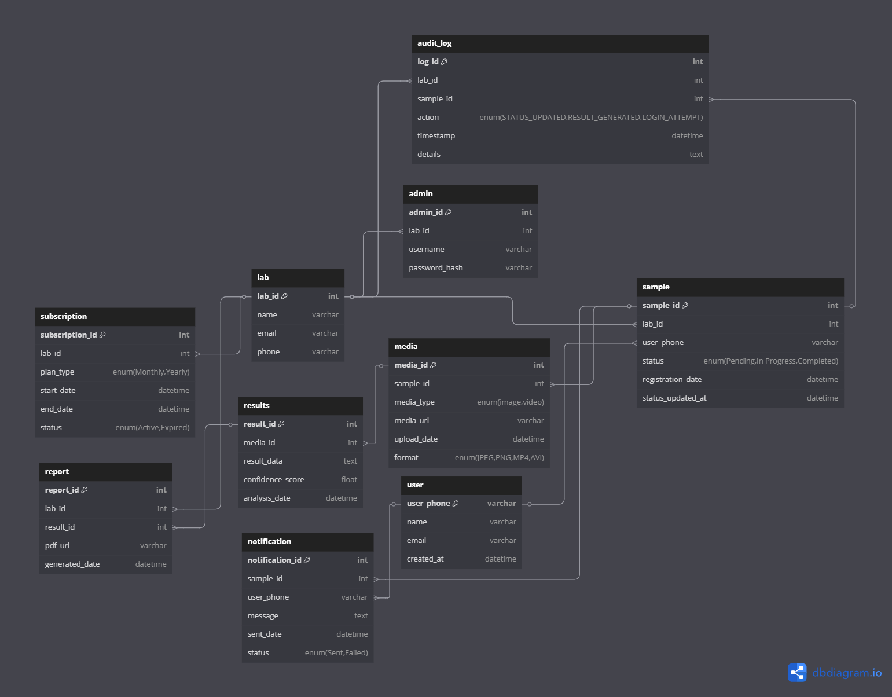
Database Design

Slide 31
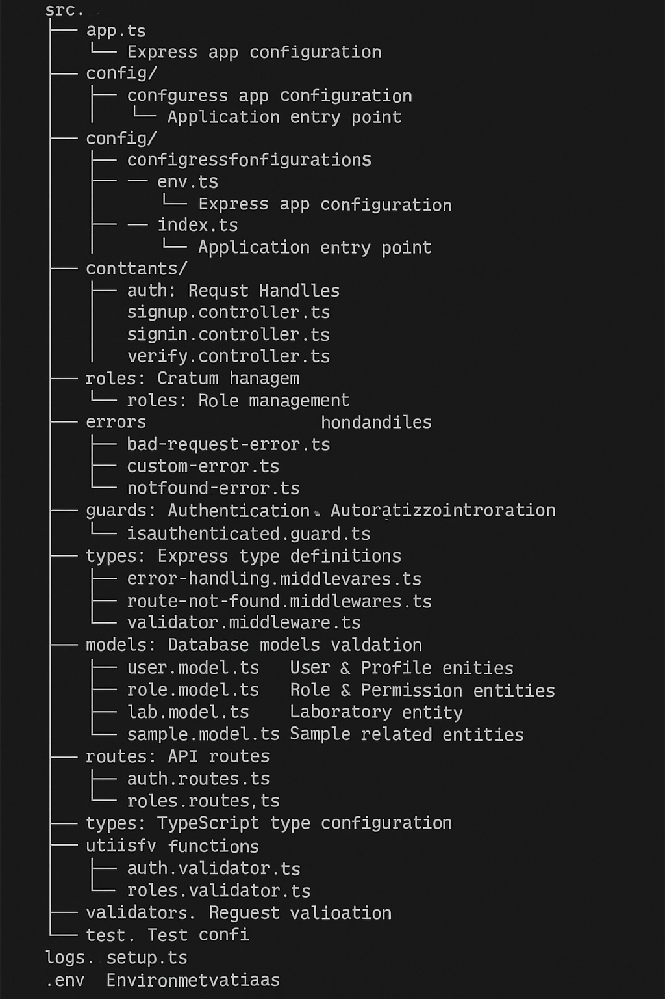
Backend structure
folder structure of a medical laboratory backend system built with TypeScript and Express.js. It includes directories for configuration, authentication, middleware, models, routes, and utilities. Each folder is organized by function, such as controllers, models, validators, and guards. The structure supports clean architecture, making the codebase modular and scalable.

Slide 32
Demo Flow:
1:User enters a question (Arabic or English).
2:System detects language.
3:Checks:
-Predefined sperm answers (for Arabic fertility questions).
-Cache.
-Otherwise, live search with Groq + tools.
4:Optional translation of response.
5:Answer is stored in history and displayed in UI.

Slide 33
Frontend

Slide 34

User Interface (UI)
We used Figma as an environment to build the app UI.
Tools used are plugins: Iconify, Unsplash, Ui faces and a little mockup.
Tools in Figma that aided the design process:
Components: streamlines edits by allowing changes to propagate throughout the design.
Auto Layouts: Automatically organize elements without additional adjustments.

Slide 35
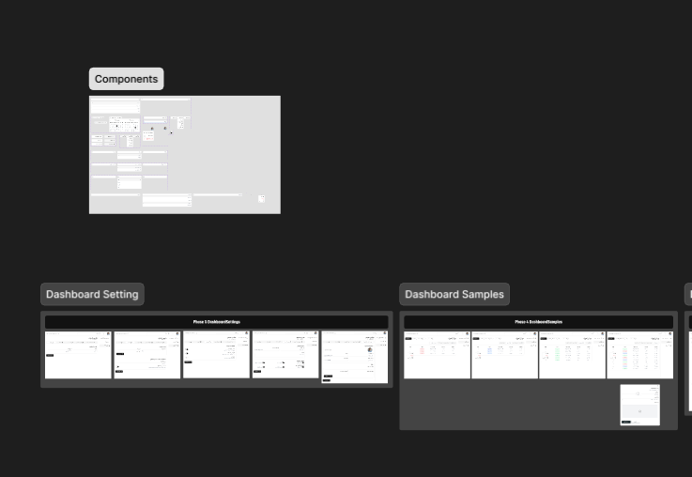
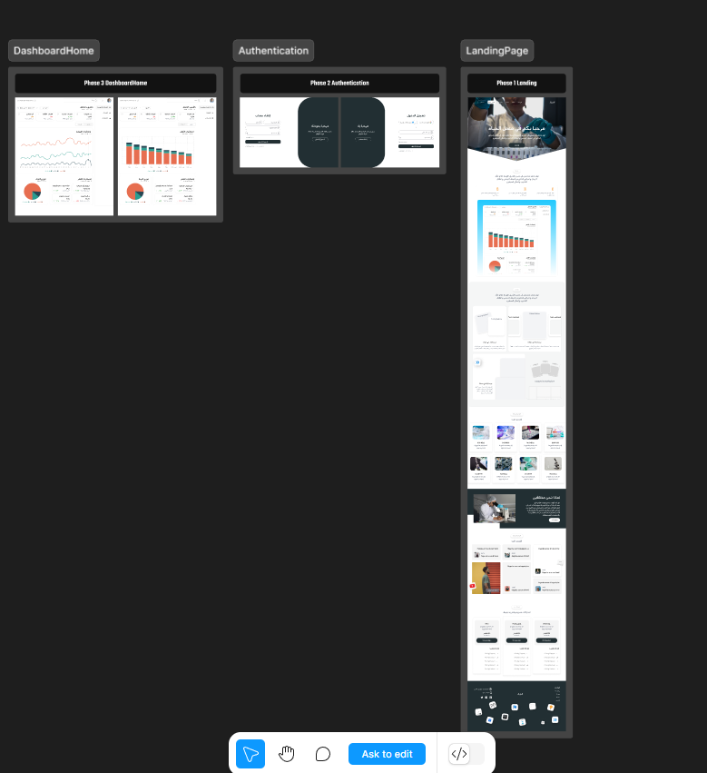
User Interface (UI)
Prototyping
A prototype is an initial model developed to meet key requirements.
Early modeling saves time and costs by identifying usability issues early, improving designs before production begins.

Slide 36
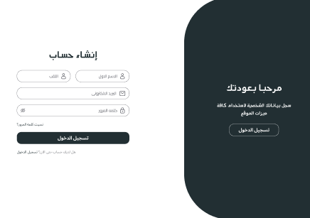
Registration Page
This page lets users either create a new account by entering their first name, last name, and password, or log in if they already have an account. The left side is for registration, and the right side invites returning users to sign in.

Slide 37
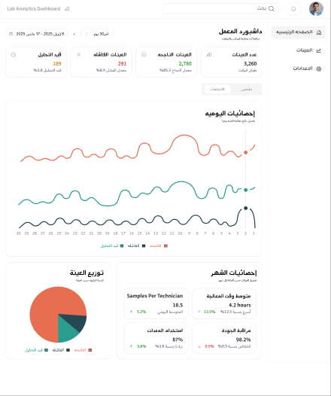
Analytics Dashboard Page
This page is a Lab Analytics Dashboard displaying key performance metrics like total operations, sample distributions, and technician statistics over time. It provides daily trends, sample breakdowns, and monthly performance insights to monitor lab efficiency.

Slide 38
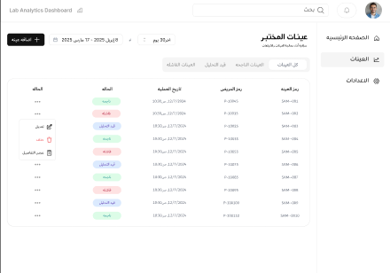
Samples Management Page
This page shows a Lab Samples Management table listing sample details like ID, date, technician ID, and current status. It helps track and manage lab sample progress through different workflow stages.

Slide 39
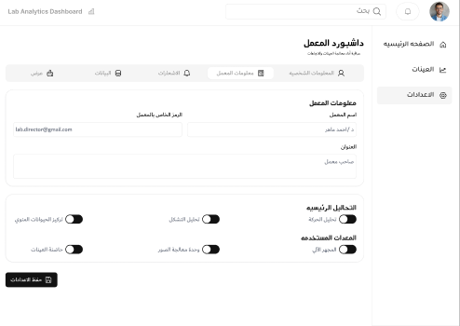
Settings Page
This page is for Lab Director Profile Settings, allowing the user to update contact information and configure main and additional analytics options. It also includes a "Save Changes" button to apply the updates.

Slide 40
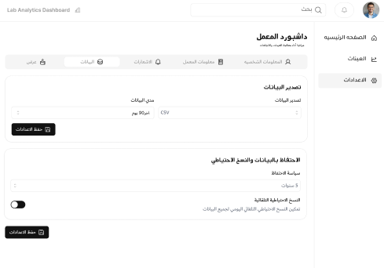
Export Data Settings
This page is the Export Data Settings section of a Lab Analytics Dashboard, allowing users to export lab data in CSV format and manage data retention and sharing policies. It provides options to save settings and toggle data-sharing preferences.

Slide 41
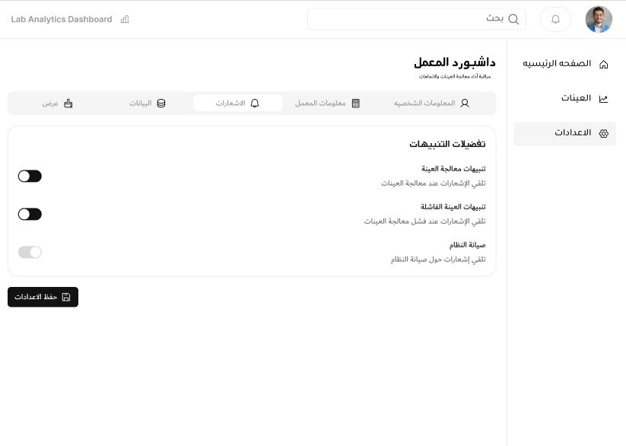
Notifications Settings
This page is the Notifications Settings section of the Lab Analytics Dashboard, where users can enable or disable alerts for sample processing, sample failures, and system maintenance. Users can save their preferences after adjusting notification settings.

Slide 42
Thanks!

